Slide 1


Xamarin
Introduction to Xamarin
Allan Pead - @adpead
Xamarin Insider, Xamarin Premier Consultant Partner

Slide 2
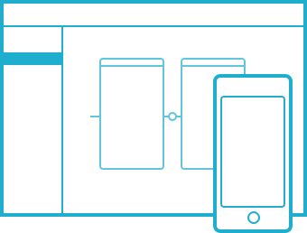
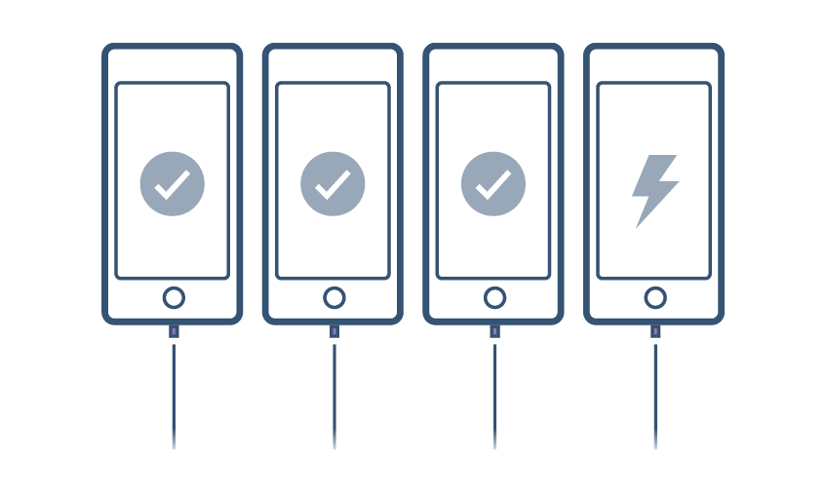







Complete mobile lifecycle solution
BUILD
TEST
MONITOR
ACCELERATE
One platform to build native apps for iOS and Android
Test any app on 2,000+ real devices in the cloud
Monitor performance and user behavior in live apps
Train your team and accelerate projects with deep expertise

Slide 3
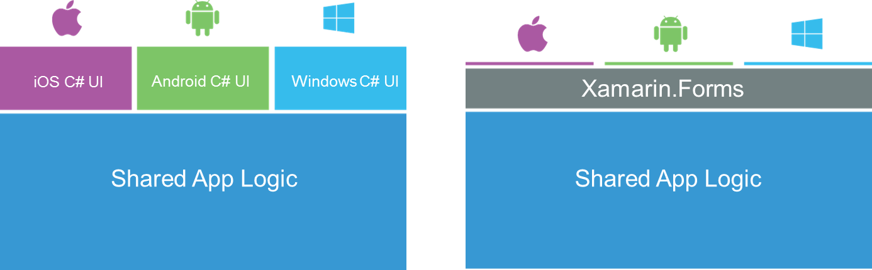
Xamarin’s Unique Approach
Xamarin exposes 100% of the native APIs for iOS, Android and Windows

Slide 4
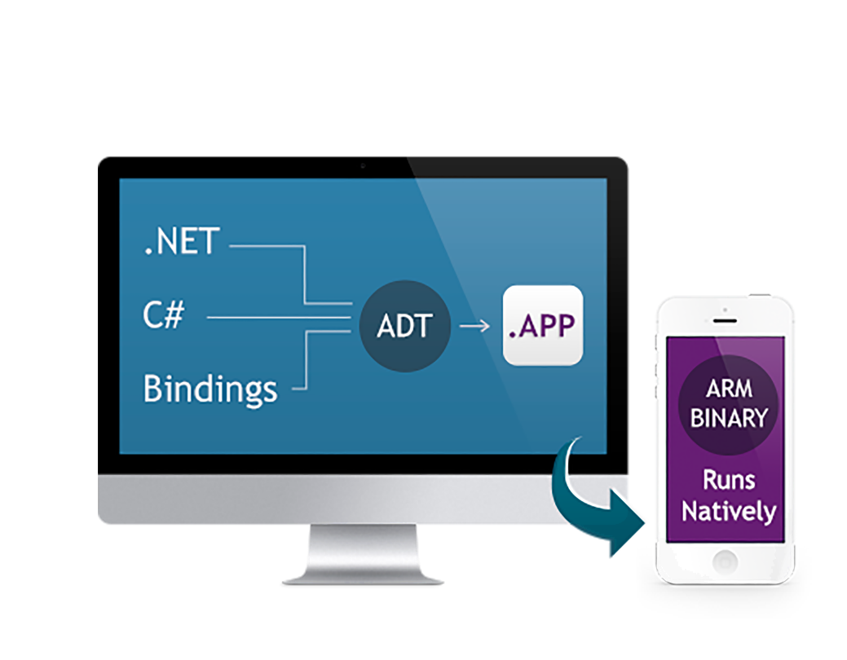
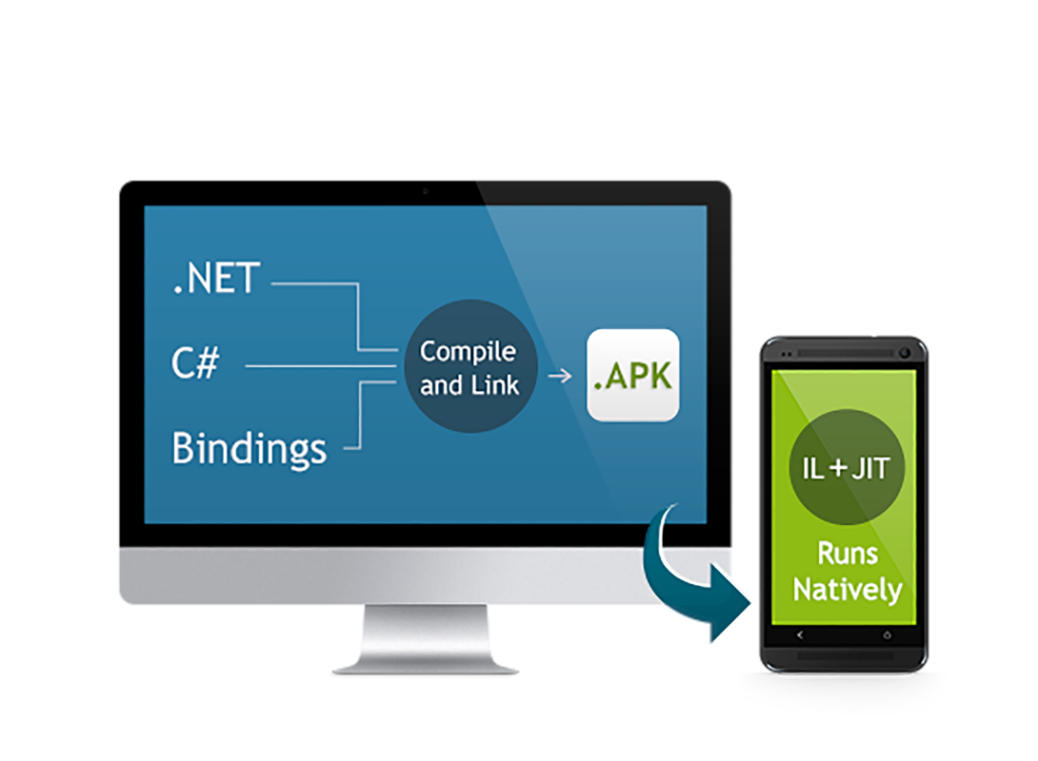

Native Performance
Xamarin.iOS does full Ahead Of Time (AOT) compilation to produce an ARM binary for Apple’s App Store.
Xamarin.Android takes advantage of Just In Time (JIT) compilation on the Android device.

Slide 5
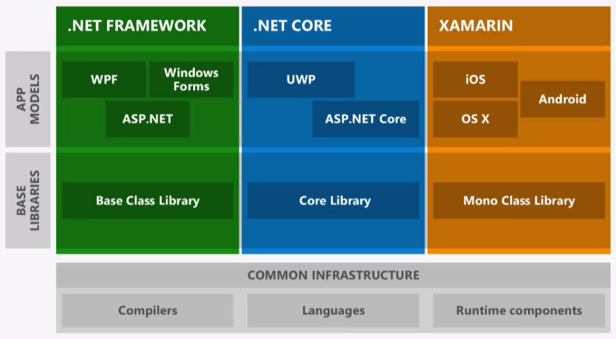
.NET Today

Slide 6
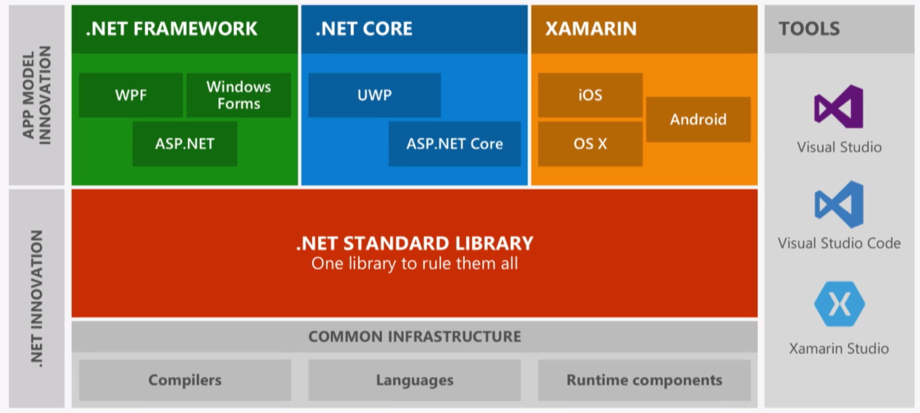
.NET Future Innovation

Slide 7
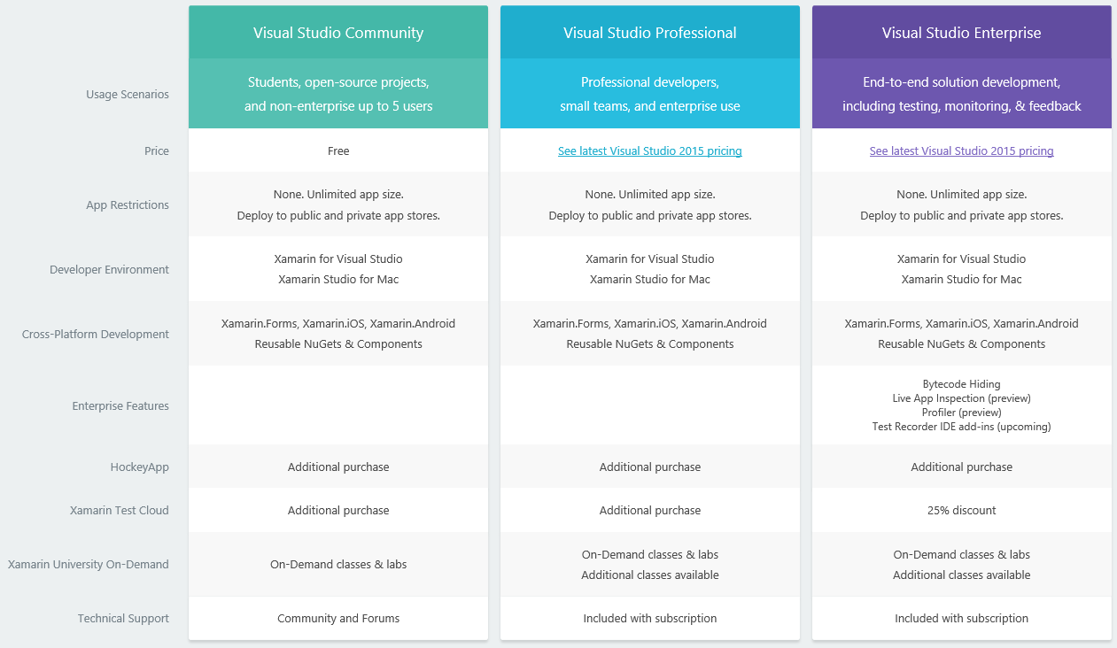

Slide 8
Where to get help
Xamarin Learning Resources
https://developer.xamarin.com/guides/
Xamarin University
https://www.xamarin.com/university
MSDN Benefits!
Learn and share with your local community
Xamarin User Groups
Cape Town (@CTXUG)
Johannesburg (@GXUGSA)
Durban (@DXUGSA)
Slack
https://zadevelopers.slack.com #xamarin

Slide 9
Xamarin University
https://university.xamarin.com/classes/track/all
https://university.xamarin.com/guestlectures
https://university.xamarin.com/lightninglectures
Unlimited access to live training from mobile experts on your schedule for only $1,995 for the first year and $1,499 for each year thereafter.
https://tim.klingeleers.be/2016/06/09/xamarin-university-worth-it/

Slide 10
Xamarin Dev Days South Africa!
09:00 AM – 09:30 AM Registration
09:30 AM – 10:10 AM Intro Xamarin presentation
10:20 AM – 11:00 AM Cross-platform Xamarin presentation
11:10 AM – 11:50 AM Cloud Xamarin presentation
12:00 PM – 13:00 PM Lunch
01:00 PM – 16:00 PM Hackathon Challenge Walkthrough
https://www.xamarin.com/dev-days
#XamarinDevDays

